Slide 1
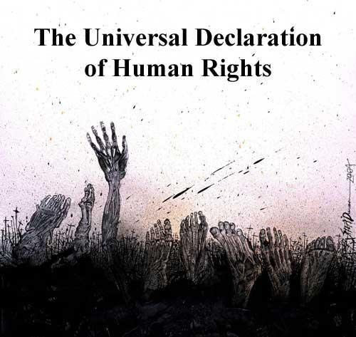
The Universal Declaration of Human Rights

Slide 2
History
WWII had just occurred and the international community recognized the need for a statement of rights agreed upon by the international community.
Franklin and Eleanor Roosevelt were instrumental in helping to provide support for the production of such a document.

Slide 3
Where do Rights come from?
Human Right are based on values of:
Dignity
Justice
Respect
Equality
Human rights were Officially recognized as value by the world when the United Nations was set up

Slide 4
The Document
Principle drafter was John Peters Humphrey who was Canadian
Adopted in 1948
48 countries voted yes, 0 no, 8 abstentions
Preamble
30 Articles
Not recognized as law…a Declaration of Human Rights

Slide 5


Slide 6
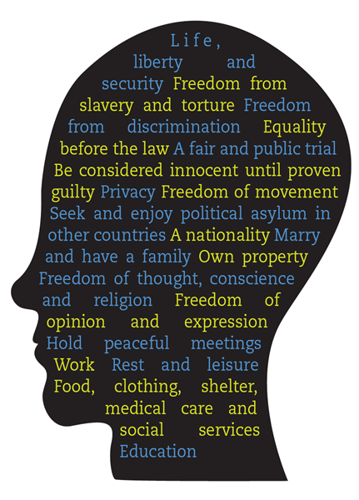
According to the
UDHR, you have
the right to:

Slide 7
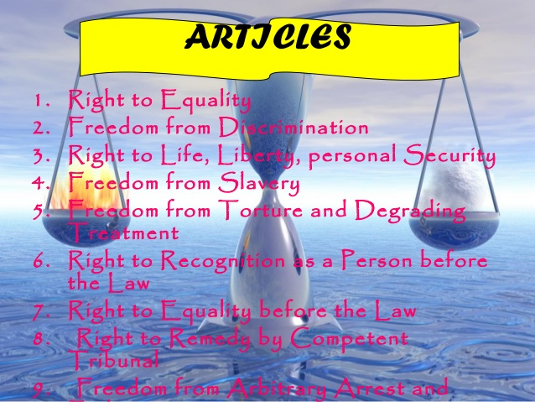
10. Equality to a fair and public hearing by an independent and impartial tribunal

Slide 8
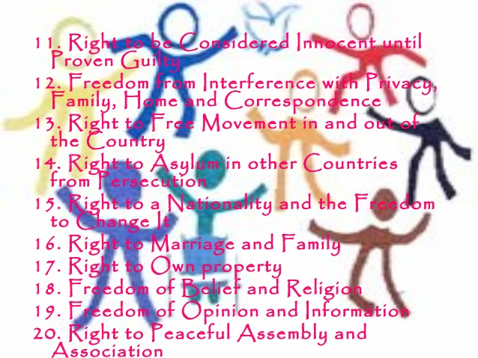

Slide 9
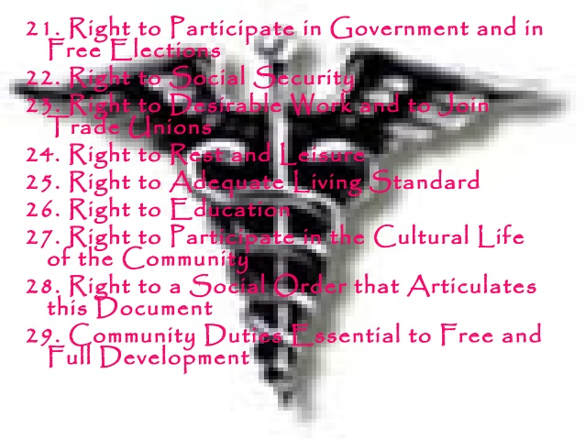

Slide 10
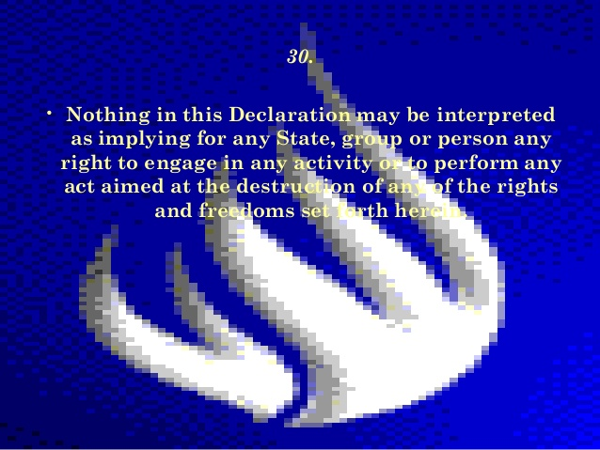

Slide 11
Activity 1
List up the 8 most important rights in UDHR as per your choice and then
Working in small groups, identify what you all think are the eight most important rights in the Universal Declaration of Human Rights and why. If you cannot agree on eight, list the candidates for inclusion and why you could not agree on them.

Slide 12
Activity 2
List up all the clauses of UCHR in a comparison table and schedule the corresponding clauses and text from of the
Cairo Declaration on Human Rights in Islam
Add your comments and compare each clause

